Slide 1
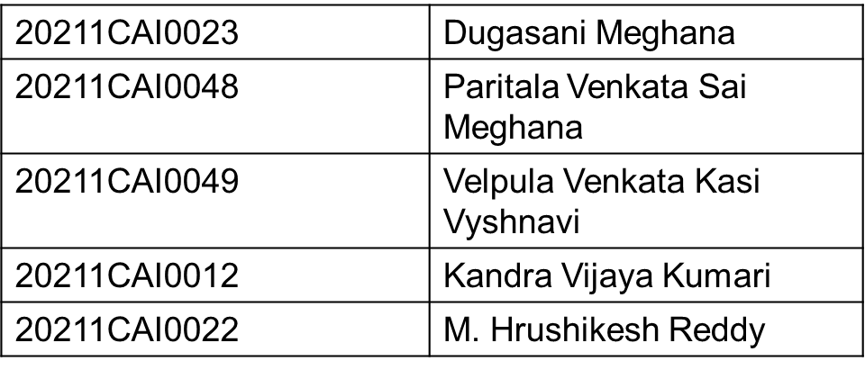
Diagnosis of acute diseases in villages and smaller towns using AI
PIP104 PROFESSIONAL PRACTICE-II
VIVA-VOCE
Batch Number: G-013
Roll Number
Student Name
Under the Supervision of,
Dr. Sasidhar Babu Suvanam
Professor
School of Computer Science and Engineering
Presidency University

Slide 2
Introduction of our Project
Healthcare accessibility in India, particularly in rural and smaller towns, has long been a challenge due to the shortage of doctors and healthcare facilities. With a significant proportion of the population residing in these areas, healthcare disparities are evident, contributing to high mortality rates from treatable conditions.

Slide 3
Telemedicine has been proposed as a solution, but its implementation and scalability have faced numerous obstacles, such as internet connectivity issues, lack of proper infrastructure, and limited availability of healthcare professionals.This project explores the development of an AI-based system designed to diagnose acute everyday diseases (e.g., common cold, flu, fever) by analyzing responses to simple questions, thereby filling a critical gap in healthcare delivery.

Slide 4
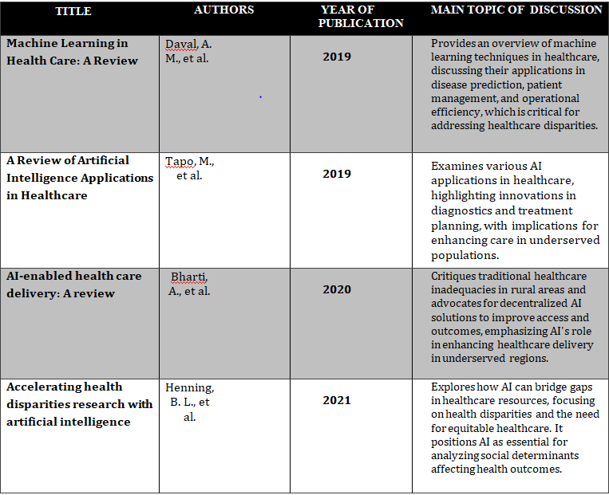
Literature Review

Slide 5
Research Gaps Identified
Data Availability and Quality: One major research gap is the lack of high-quality, diverse datasets that represent the healthcare needs of rural populations. Many AI models are trained on urban and clinical data, which may not capture the unique health challenges faced in rural areas, including the prevalence of certain diseases and the variation in symptom reporting.

Slide 6
Algorithm Generalizability: Existing AI models often struggle with generalizability across different populations and contexts. An AI system trained in one region or demographic may not work effectively in another due to differences in language, healthcare access, and disease prevalence. Research needs to focus on creating algorithms that are adaptable and reliable in various low-resource environments.

Slide 7
Proposed Methodology
We propose an AI-based "doctor" system capable of diagnosing common acute diseases based on a set of predefined questions. The system utilizes a decision tree classifier, a machine learning model, to analyze user-provided symptoms, generate potential diagnoses, and offer recommendations for treatment, including doctor suggestions and doctor availability time. The model is trained on a comprehensive dataset of common symptoms and diseases, enabling accurate and reliable diagnostic capabilities.

Slide 8
This system is designed to function effectively in regions with limited or no internet connectivity and is optimized to run on low-cost devices or through existing digital assistants. By addressing the challenges of existing diagnostic systems in rural and smaller towns, this AI-powered tool offers real-time diagnosis of common acute diseases such as cold, flu, and fever. Its accessible design ensures healthcare support for underserved populations, improving medical access and outcomes.

Slide 9
Objectives
Enhance healthcare accessibility: Provide immediate diagnosis for common acute diseases in remote areas.
Leverage ML: Utilize’s Decision Tree Classifier to accurately interpret patient symptoms.
Offline Capability: Develop a solution that can work even in areas with intermittent or no internet.
User-Friendly Interface: Design an easy-to-use interface to ensure adoption in rural areas.

Slide 10
System design and Implementation
The design and implementation of an AI-based healthcare diagnostic tool for diagnosing acute diseases in rural areas requires careful consideration of various components, from user interfaces to backend machine learning models.
The system includes:
A user-friendly web interface built with HTML, CSS, and Django framework.
A machine learning model (Decision Tree Classifier) trained on a dataset of symptoms and diagnoses.
Treatment recommendations and doctor details dynamically populated based on diagnosis.
Feedback collection module for continuous improvement.

Slide 11
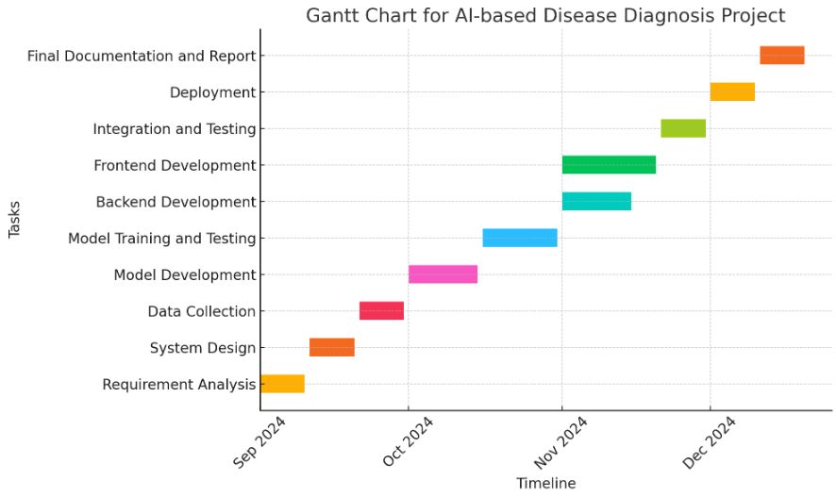
Timeline of Project

Slide 12
Outcomes/Results Obtained
Accurate Diagnosis: The AI system will diagnose common acute diseases with an accuracy of over 80%.
Improved Healthcare Accessibility: Villages and smaller towns will have access to instant diagnostic services without the need for travel.
Scalability: The AI-based solution will be scalable to cover a wide variety of diseases as more data is collected and processed.
Seamless Usability and Scalable Potential: User feedback highlights ease of use and potential for wide-scale deployment.

Slide 13
Conclusion
The development of an AI-based healthcare solution leveraging machine learning models like decision trees and Django holds immense potential to transform healthcare in rural India. By providing timely and accurate diagnostics, this solution can address the challenges of healthcare accessibility and improve diagnosis accuracy in remote areas. Such innovations not only reduce the burden on healthcare systems but also enhance patient outcomes, ultimately contributing to the overall well-being of populations in smaller towns and villages.

Slide 14
References
Kumar Y, Koul A, Singla R, Ijaz MF. "Artificial intelligence in disease diagnosis: a systematic literature review, synthesizing framework and future research agenda." J Ambient Intell Humaniz Comput. 2023;14(7):8459-8486. doi:10.1007/s12652-021-03612-z.
Guo, Jonathan & Li, Bin. (2018). "The Application of Medical Artificial Intelligence Technology in Rural Areas of Developing Countries." Health Equity. 2:174-181. doi:10.1089/heq.2018.0037.
Pathak, Chandramaprasad and Ansari, Namrata. "Chatbot based Disease Prediction and Treatment Recommendation using AI." (May 7, 2021).

Slide 15
Fan X, Chao D, Zhang Z, Wang D, Li X, Tian F. "Utilization of Self-Diagnosis Health Chatbots in Real-World Settings: Case Study." J Med Internet Res. 2021 Jan 6;23(1)
Diagnosis Of Acute Diseases In Villages And SmallerTowns Using AIMohammed Naseeruddin Taufiq, Bandaru Bhavagna Shreya, Sahil Anil Thole Chitra S, A.Mohammed A
Using AI, Diagnosis of Acute Diseases in Villages and Smaller TownsMadhu H T1, Sachin S2, Manjunath Kavishetti3 , Puneeth4 , Karthik Mahesh Gadyal5

Slide 16
Publication Details
Submission date: 06-Jan-2025 11:35AM (UTC+0530)
Submission ID: 2560137303
File name: iagnosis_of_acute_diseases_in_villages_and_smaller_towns_2.docx (814K)
Word count: 2998
Character count: 19658

Slide 17

Thank You

